Slide 1
Lecture 9: Defensive Behavior and Self Protection
Prof. Parthum
Environmental Economics Econ 475

Slide 2
Defensive Behavior
When people are faced with a risk or danger, they are often (occasionally?) able to act in a way that reduces either their chances of facing that risk, or the severity of the bad outcome.
What are examples of things that you do to help protect yourself from risk?
Wear a seat belt or a bicycle helmet, other safety items like steel toed boots or harnesses when on a roof
Personal security steps such as a passcode on your phone. Aside, what’s with the GU passwords!? Every day it’s a gamble on if we’ll have class.
Financial security such as diversifying your investments (think small, not likely many of us are managing large stock funds).
Risks to assets such as rental or auto insurance, obviously health insurance
These are useful observations because they are revealed behaviors that give insight into how people respond to everyday risks.

Slide 3
Defensive Behavior
When people are faced with a risk or danger, they are often (occasionally?) able to act in a way that reduces either their chances of facing that risk, or the severity of the bad outcome.
What are examples of things that you do to help protect yourself from risk?
Wear a seat belt or a bicycle helmet, other safety items like steel toed boots or harnesses when on a roof
Personal security steps such as a passcode on your phone. Aside, what’s with the GU passwords!? Every day it’s a gamble on if we’ll have class.
Financial security such as diversifying your investments (think small, not likely many of us are managing large stock funds).
Risks to assets such as rental or auto insurance, obviously health insurance
These are useful observations because they are revealed behaviors that give insight into how people respond to everyday risks.

Slide 4
Defensive Behavior
When people are faced with a risk or danger, they are often (occasionally?) able to act in a way that reduces either their chances of facing that risk, or the severity of the bad outcome.
What are examples of things that you do to help protect yourself from risk?
Wear a seat belt or a bicycle helmet, other safety items like steel toed boots or harnesses when on a roof
Personal security steps such as a passcode on your phone. Aside, what’s with the GU passwords!? Every day it’s a gamble on if we’ll have class.
Financial security such as diversifying your investments (think small, not likely many of us are managing large stock funds).
Risks to assets such as rental or auto insurance, obviously health insurance
These are useful observations because they are revealed behaviors that give insight into how people respond to everyday risks.

Slide 5
Defensive Behavior
When people are faced with a risk or danger, they are often (occasionally?) able to act in a way that reduces either their chances of facing that risk, or the severity of the bad outcome.
What are examples of things that you do to help protect yourself from risk?
Wear a seat belt or a bicycle helmet, other safety items like steel toed boots or harnesses when on a roof
Personal security steps such as a passcode on your phone. Aside, what’s with the GU passwords!? Every day it’s a gamble on if we’ll have class.
Financial security such as diversifying your investments (think small, not likely many of us are managing large stock funds).
Risks to assets such as rental or auto insurance, obviously health insurance
These are useful observations because they are revealed behaviors that give insight into how people respond to everyday risks.

Slide 6
Defensive Behavior
For nonmarket goods (or bads), there are common mitigation or abatement measures that people take to protect themselves from their environment. Can you think of any examples?
Air Pollution
Install air filters, air conditioners, or move away entirely
Water Pollution
Water filters, bottled water, test more frequently/drill a deeper well, move
Noise Pollution
Better windows/doors, insulation, move
Climate Change
Find a job where you can work inside, move away from the equator, live in a developed country

Slide 7
Defensive Behavior
For nonmarket goods (or bads), there are common mitigation or abatement measures that people take to protect themselves from their environment. Can you think of any examples?
Air Pollution
Install air filters, air conditioners, or move away entirely
Water Pollution
Water filters, bottled water, test more frequently/drill a deeper well, move
Noise Pollution
Better windows/doors, insulation, move
Climate Change
Find a job where you can work inside, move away from the equator, live in a developed country

Slide 8
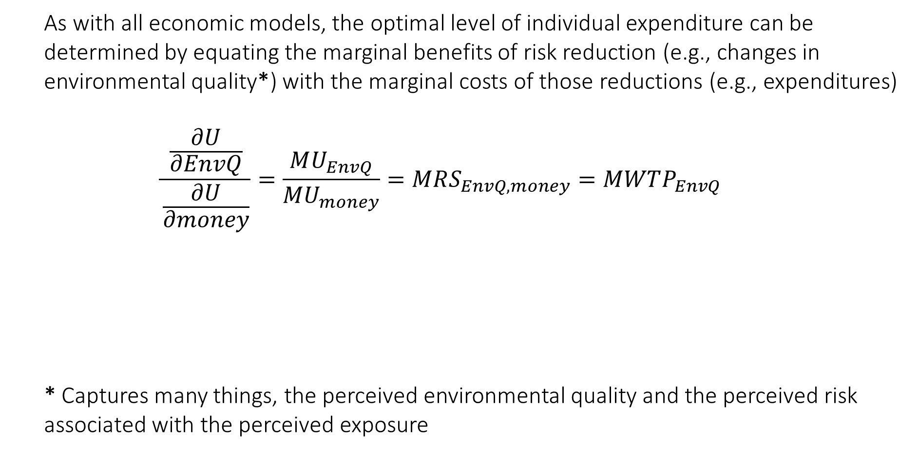
The Model
As with all economic models, the optimal level of individual expenditure can be determined by equating the marginal benefits of risk reduction (e.g., changes in environmental quality*) with the marginal costs of those reductions (e.g., expenditures)
$$\frac{\frac{∂U}{∂EnvQ}}{\frac{∂U}{∂money}}=\frac{MU_{EnvQ}}{MU_{money}}=MRS_{EnvQ, money}=MWTP_{EnvQ}$$
One common way to estimate $MWTP_{EnvQ}$ is through observed expenditures
$$cost_{it}=β_{1}+β_{2}EnvQ+Xβ+φ+ε_{it}$$
* Captures many things, the perceived environmental quality and the perceived risk associated with the perceived exposure

Slide 9
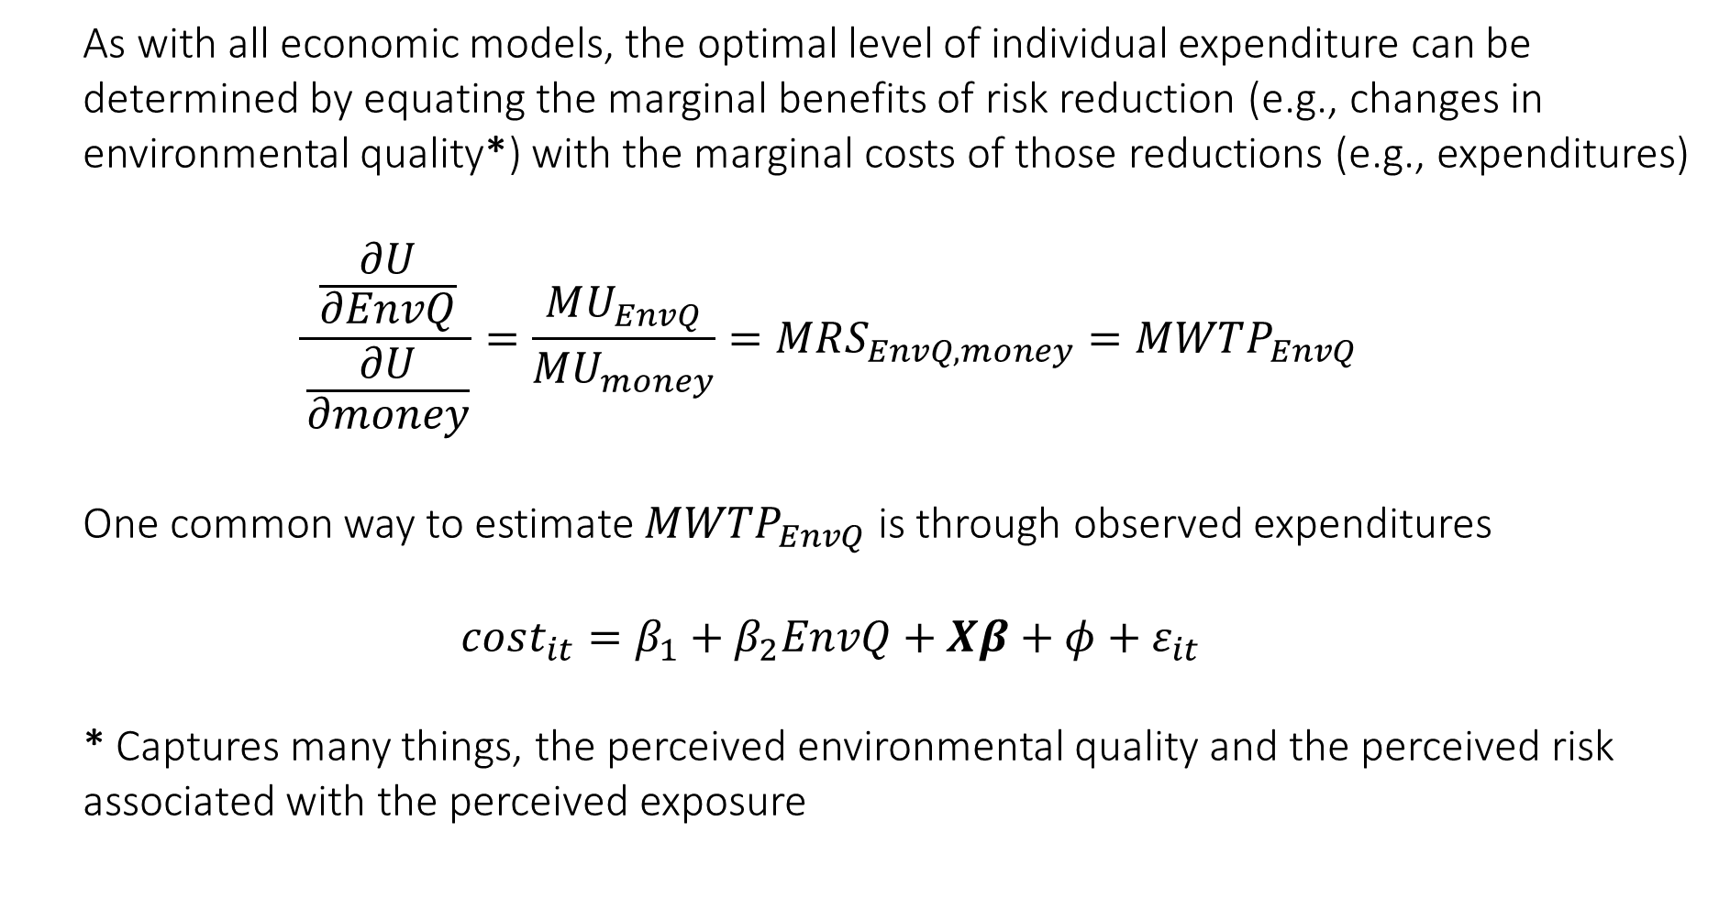
The Model
As with all economic models, the optimal level of individual expenditure can be determined by equating the marginal benefits of risk reduction (e.g., changes in environmental quality*) with the marginal costs of those reductions (e.g., expenditures)
$$\frac{\frac{∂U}{∂EnvQ}}{\frac{∂U}{∂money}}=\frac{MU_{EnvQ}}{MU_{money}}=MRS_{EnvQ, money}=MWTP_{EnvQ}$$
One common way to estimate $MWTP_{EnvQ}$ is through observed expenditures
$$cost_{it}=β_{1}+β_{2}EnvQ+Xβ+φ+ε_{it}$$
* Captures many things, the perceived environmental quality and the perceived risk associated with the perceived exposure

Slide 10

The Model
$$cost_{it}=β_{1}+β_{2}EnvQ+Xβ+φ+ε_{it}$$
where
$$\frac{∂cost}{∂EnvQ}=β_{2}=MWTP_{EnvQ}$$
The dependent variable $cost$ can mean many things.
Cost of a hospital visit, asthma treatments, etc. But what are some issues with using this approach? Health care, especially in the U.S., is not particularly transparent in its costs.
Defensive expenditures, things like air purifiers, water filters, etc. Can you think of any potential issues with this measure?

Slide 11
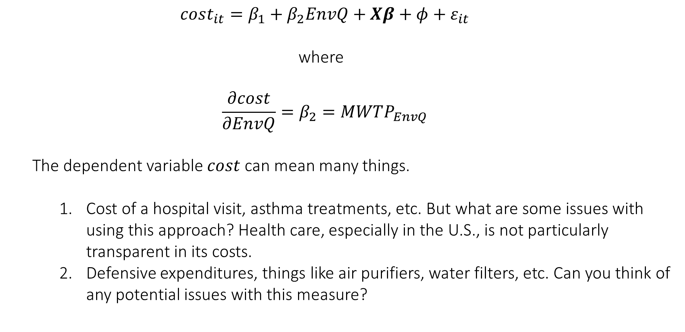
The Model
$$cost_{it}=β_{1}+β_{2}EnvQ+Xβ+φ+ε_{it}$$
where
$$\frac{∂cost}{∂EnvQ}=β_{2}=MWTP_{EnvQ}$$
The dependent variable $cost$ can mean many things.
Cost of a hospital visit, asthma treatments, etc. But what are some issues with using this approach? Health care, especially in the U.S., is not particularly transparent in its costs.
Defensive expenditures, things like air purifiers, water filters, etc. Can you think of any potential issues with this measure?

Slide 12
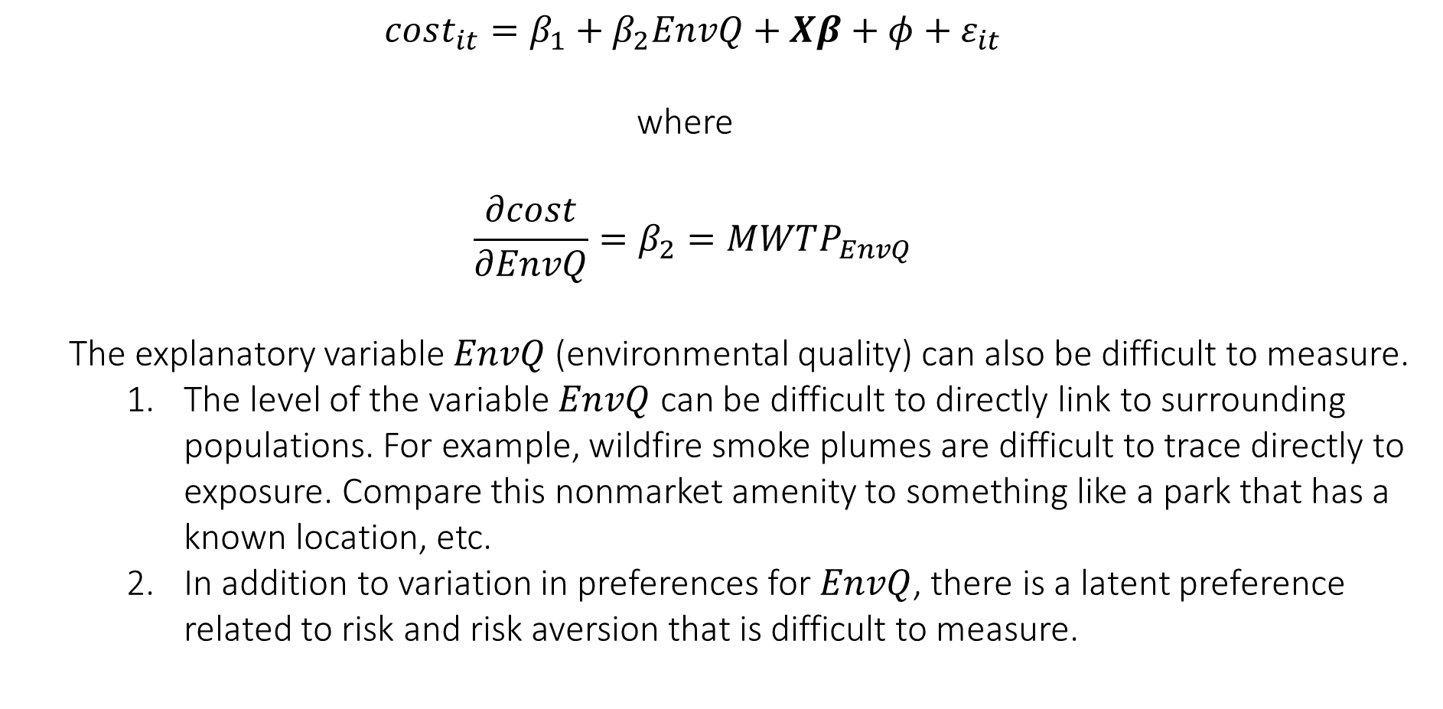
The Model
$$cost_{it}=β_{1}+β_{2}EnvQ+Xβ+φ+ε_{it}$$
where
$$\frac{∂cost}{∂EnvQ}=β_{2}=MWTP_{EnvQ}$$
The explanatory variable $EnvQ$ (environmental quality) can also be difficult to measure.
The level of the variable $EnvQ$ can be difficult to directly link to surrounding populations. For example, wildfire smoke plumes are difficult to trace directly to exposure. Compare this nonmarket amenity to something like a park that has a known location, etc.
In addition to variation in preferences for $EnvQ$, there is a latent preference related to risk and risk aversion that is difficult to measure.

Slide 13
Self-Protection and Value of Statistical Life Estimation
By: Shogren and Stamland (2005)
Abstract: Self-protection has been used to help define lower bounds on the value of statistical life (VSL). We show circumstances exist in which (1) the lower bounds are so low as to be more misleading than informative; and (2) the bound is an upper bound on the population's average VSL. The relationship between the bound and VSL depends on the degree and nature of individual heterogeneity, the fraction of the population buying self-protection, and the price and market setting for self-protection. Although some factors are observable, their impact is difficult to assess because they interact with unobservable population characteristics.
Definition:
“…self-protection are investments to reduce either the probability of a bad outcome or the severity of the bad outcome or both.”

Slide 14
Self-Protection and Value of Statistical Life Estimation
By: Shogren and Stamland (2005)
Abstract: Self-protection has been used to help define lower bounds on the value of statistical life (VSL). We show circumstances exist in which (1) the lower bounds are so low as to be more misleading than informative; and (2) the bound is an upper bound on the population's average VSL. The relationship between the bound and VSL depends on the degree and nature of individual heterogeneity, the fraction of the population buying self-protection, and the price and market setting for self-protection. Although some factors are observable, their impact is difficult to assess because they interact with unobservable population characteristics.
Definition:
“…self-protection are investments to reduce either the probability of a bad outcome or the severity of the bad outcome or both.”

Slide 15
Self-Protection and Value of Statistical Life Estimation
By: Shogren and Stamland (2005)
Motivation:
The value people place on marginal reductions in health risk is incredibly valuable for benefit cost analysis, and incredibly influential. Therefore, it is important to estimate with reasonable confidence and, when possible, provide bounds on the possible estimate.
Research Question:
Is the bounding doing what we think it is doing?
Perhaps not. The idiosyncratic nature of they way in which people respond to risk, combined with data limitations, makes for potentially misleading estimates.

Slide 16

Self-Protection and Value of Statistical Life Estimation
By: Shogren and Stamland (2005)
The value that we estimate is the MWTP for $EnvQ$ conditional on the decision to self protect, or $MWTP_{EnvQ|self protection}$
It is fairly safe to say that this is a lower bound on $MWTP_{EnvQ|self protection}$ because these are revealed behaviors.
But, the extension of these estimates to the population in aggregate is an important one because those who choose to not self protect either:
Have a lower WTP (perhaps even zero)
Are less risk averse, or skilled at defending against it
Perceive the reduction in risk differently (efficacy of the defensive mechanism)
Are simply not able to, do not have the means (money)
Are unaware of the risk entirely! (or the cost of/availability to protect)

Slide 17

Self-Protection and Value of Statistical Life Estimation
By: Shogren and Stamland (2005)
The value that we estimate is the MWTP for $EnvQ$ conditional on the decision to self protect, or $MWTP_{EnvQ|self protection}$
It is fairly safe to say that this is a lower bound on $MWTP_{EnvQ|self protection}$ because these are revealed behaviors.
But, the extension of these estimates to the population in aggregate is an important one because those who choose to not self protect either:
Have a lower WTP (perhaps even zero)
Are less risk averse, or skilled at defending against it
Perceive the reduction in risk differently (efficacy of the defensive mechanism)
Are simply not able to, do not have the means (money)
Are unaware of the risk entirely! (or the cost of/availability to protect)

Slide 18
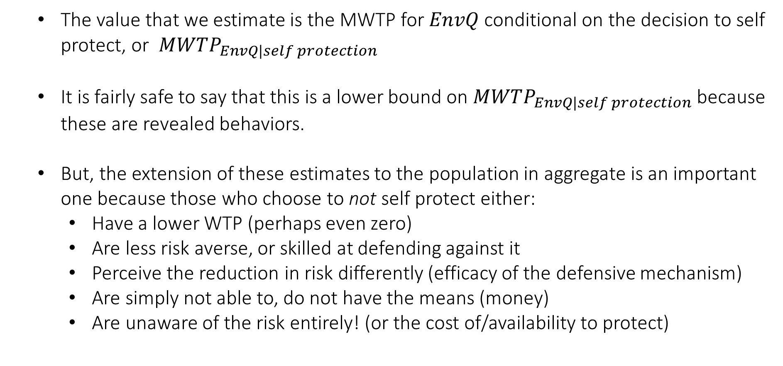
Self-Protection and Value of Statistical Life Estimation
By: Shogren and Stamland (2005)
The value that we estimate is the MWTP for $EnvQ$ conditional on the decision to self protect, or $MWTP_{EnvQ|self protection}$
It is fairly safe to say that this is a lower bound on $MWTP_{EnvQ|self protection}$ because these are revealed behaviors.
But, the extension of these estimates to the population in aggregate is an important one because those who choose to not self protect either:
Have a lower WTP (perhaps even zero)
Are less risk averse, or skilled at defending against it
Perceive the reduction in risk differently (efficacy of the defensive mechanism)
Are simply not able to, do not have the means (money)
Are unaware of the risk entirely! (or the cost of/availability to protect)

Slide 19
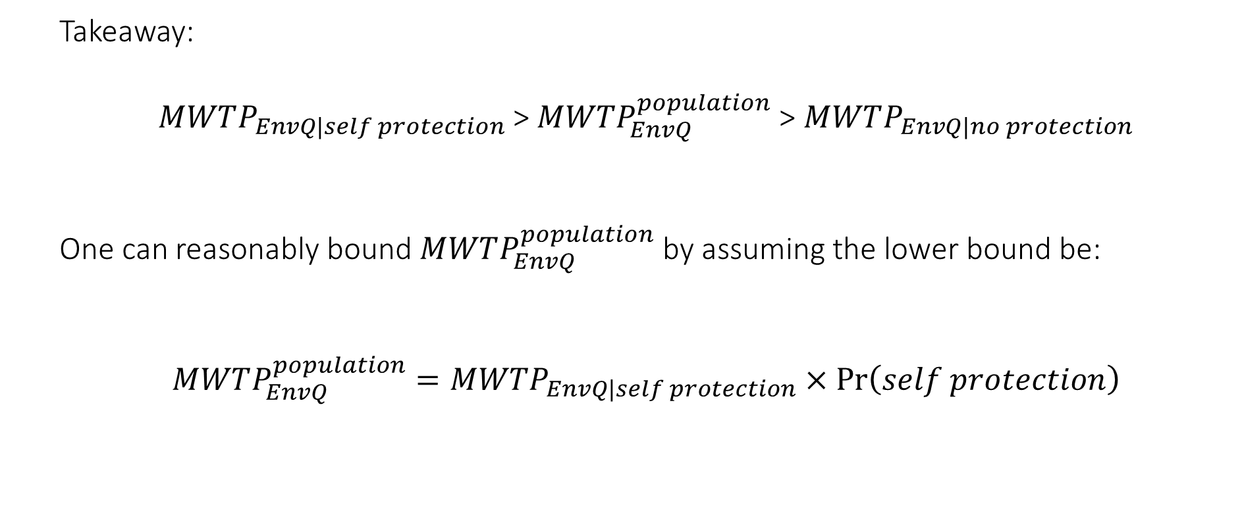
Self-Protection and Value of Statistical Life Estimation
By: Shogren and Stamland (2005)
Takeaway:
$MWTP_{EnvQ|self protection}$ > $MWTP_{EnvQ}^{population}$> $MWTP_{EnvQ|no protection}$
One can reasonably bound $MWTP_{EnvQ}^{population}$ by assuming the lower bound be:
$MWTP_{EnvQ}^{population}=MWTP_{EnvQ|self protection}×\operatorname{Pr}\left(self protection\right)$

Slide 20
Next class
Introduction to Climate Economics:
Yağmur Menzilcioğlu
Climate Policy and Imperfect Competition
Revisiting the social cost of carbon (Nordhaus 2017)
REMINDER: Case Study #1 – due tomorrow! September 27th by 11:59pm

